Slide 1
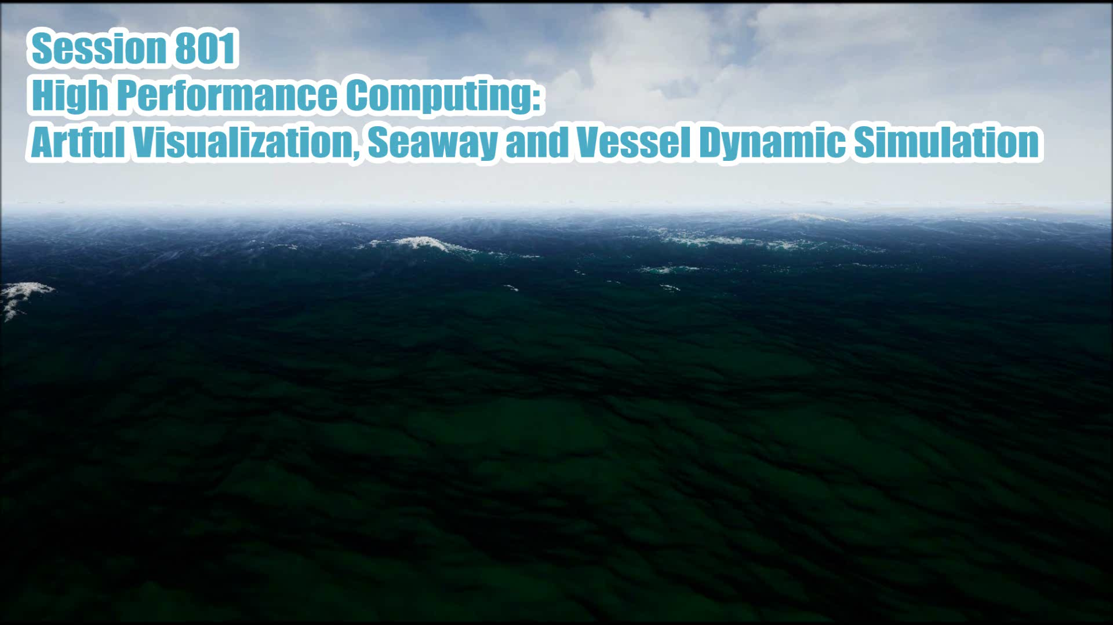

Slide 2
HOW IT ALL BEGAN
Notes:
This story starts with one simple question. – How do you get seaway data when you don’t have a boat?

Slide 3
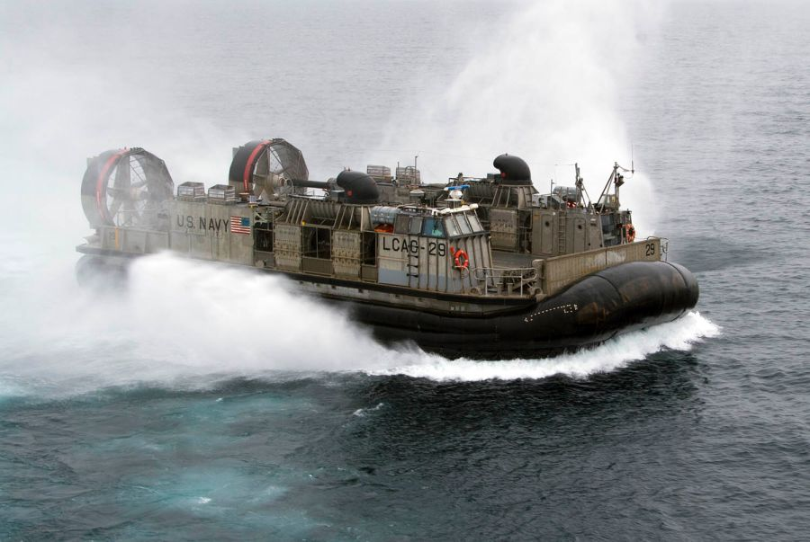
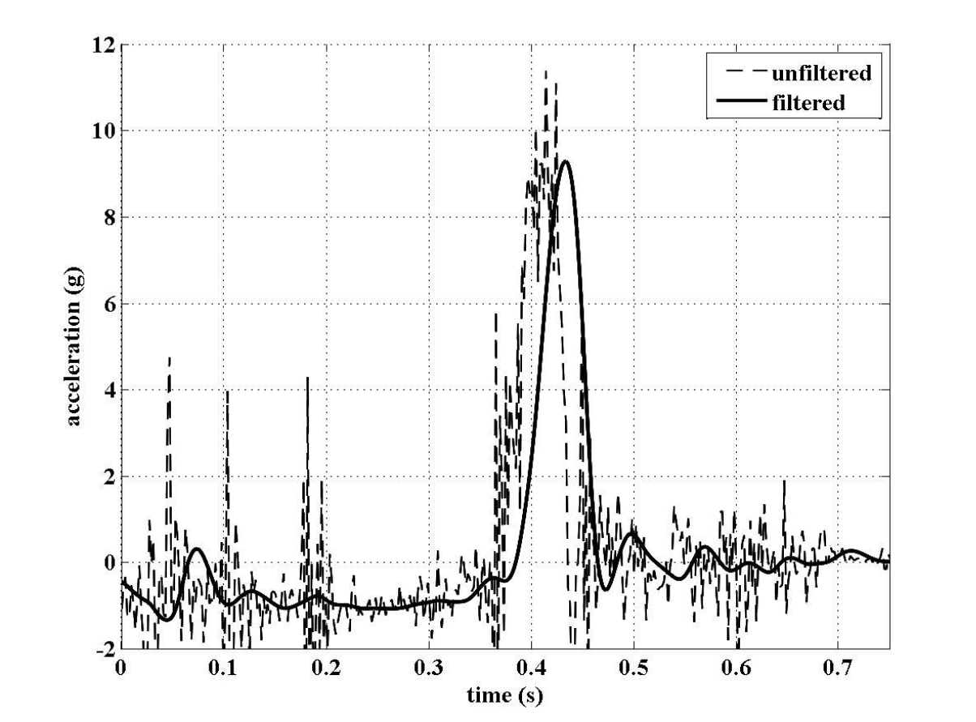
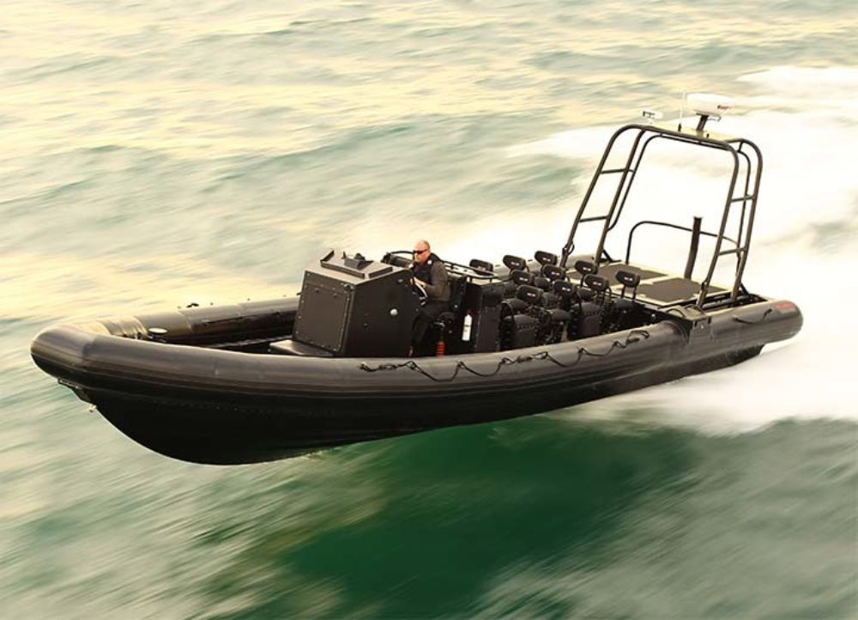
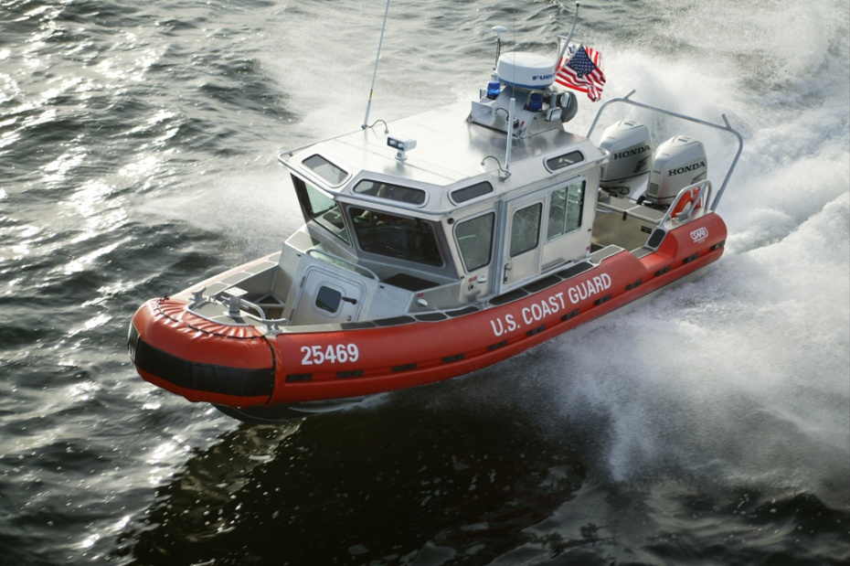
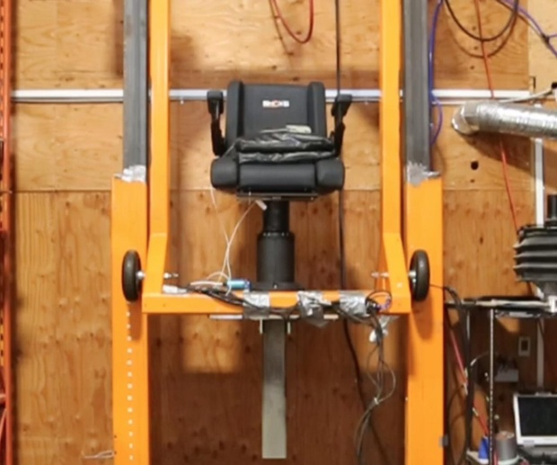

How it all began
How do you get seaway data when you don’t have a boat?
Notes:
Why?
It was always part of an effort to understand how high speed vessels reacted in a given seaway
And to design products that protected operators and passengers – enabling them to be more mission effective, prolong careers and improve after-career quality of life.

Slide 4
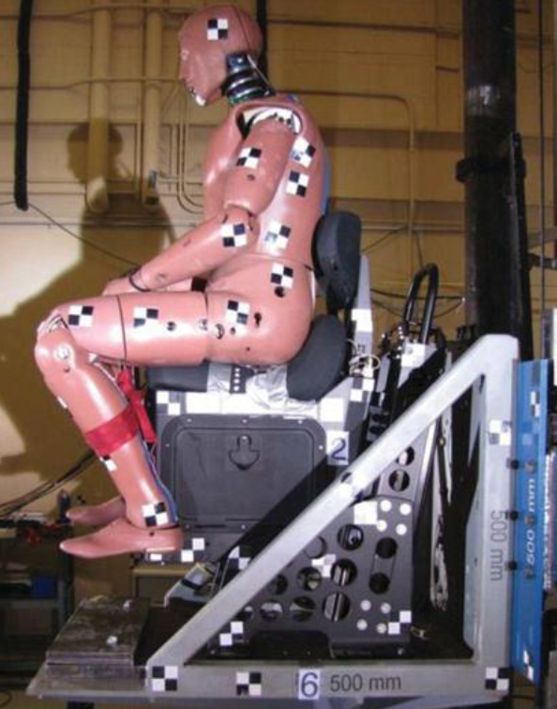

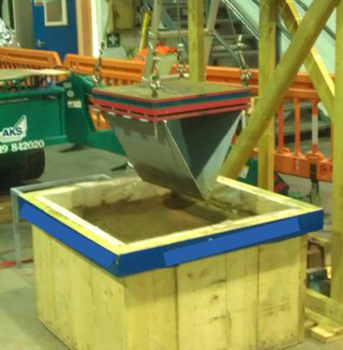
HOW IT ALL BEGAN
How do you get seaway data when you don’t have a boat?
Notes:
Anthropomophic Studies
Savitsky-Brown and the nexus of most every Classed Society design rule
Shop specific impact tests
MoD “Protocol-1”
A failed ISO group – trips to Montreal and Berlin
Investment of time & $$ among US Navy and Canadian National Research Council

Slide 5
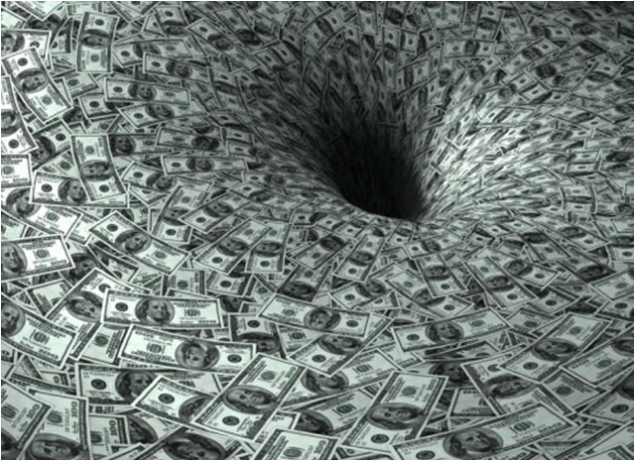
WHAT DID WE LEARN?
Notes:
Nothing??!!!’
Well – not nothing
We did learn a lot about duplicating single impact events and designing products to mitigate them
Learned a little about vibration
Met a lot of highly educated folks on the subject of shock and vibration – M.Ds, PhDs,
And a lot about the politics of competitive industry! Can’t we all just get along? Ultimately it’s about the well-being of the end user in the marine environment.
There were a few instrumented on-water tests – and we only learned about specific vessel and equipment combinations and were at the mercy of whatever seaway on the day – equipment breakdown or malfunction, partial data.
As the song goes - It’s a long way to the top, if yak want to rock-n-roll
Alternatives:
Tow Tank, Wave Pool, Simulation?
Simulation software of the day – out of the question! Too specific, too complex, too expensive.
We needed something better, something more reliable, something accessible, something – well – CHEAP!

Slide 6
THE SOLUTION
LOOK FOR RESOURCES OUTSIDE THE NORM
LEVERAGE FREELY AVAILABLE TECHNOLOGIES
DON’T BE A CONSUMER OF TECHNOLOGY – BE A DEVELOPER OF IT.

Slide 7
THE SOLUTION
LOTS OF PHYSICS BASED SIMULATION TOOLS OUT THERE
SOURCEFORGE.COM
GITHUB
NVIDIA (Phys-X, CUDA, Open-CL) & AMD (Open-CL)
Notes:
Largely these are just a sparse collection of tools – organized but not working together and require a programmers knowledge to integrate.
So – where do we find a convient integration of physics based tools that can be easily leveraged?
ANGRY BIRDS SLIDE IS NEXT

Slide 8

Notes:
Yes – I know what you’re probably thinking – what does Angry Birds have to do with vessel motions, shock & vibration and artful simulation?
ACTUALLY – QUITE A LOT!
I want to introduce the idea of the PHYSICS ENGINE
The PHYSICS ENGINE at the heart of the game manages all the objects in it and their individual physics – that give an intuitive “realness” to the behavior of objects – they seem massive, teeter on the brink of falling down, push and collide with other objects.
“springiness”, power and angle of the launcher slingshot
Trajectory of the angry bird
Collision with the obstacles
Mass reaction between the birds, and obstacles
Mass reaction between the obstacles – what collides with what.
Manages the lifetime of objects
Provides feedback of the simulated environment to the controlling program (e.g. what objects are still in play and how they move, keeps score, levels completed)
Provides a way to graphically render the scene in an artful way.

Slide 9
INITIAL STEPS

Slide 10
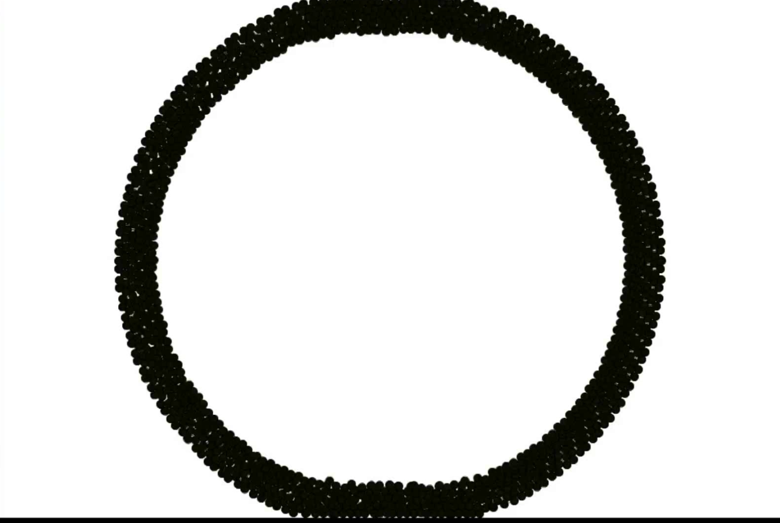
WHAT IS A PHYSICS ENGINE
Notes:
There’s two bits of technology that will be repeated over and over
Physics Engine – What is it and what does it do
GPU – Graphics Processing Unit
We’ll get to GPU in a moment.
Every simulation needs physics:
A physics engine takes care of managing the simulated “world” and the objects that are modeled within it
Makes objects move, behave and react in a real and convincing way.
Gravity
Mass
Movable and immovable objects
Friction, springiness, resiliency and restitution.
Joints between objects
Buoyancy – or multi-phase physics are typically not explicitly handled by the physics engine and must be specially resolved
Physical values can be extracted on each object:
Position and position relative to another bod
Velocity
Acceleration
Angle
Rotational velocity
Rotational acceleration
What else can we get out out the physics engine – I have a real world example everyone can appreciate….. Next slide..

Slide 11
Early Experiments
JBox-2D physics engine (same as “Angry Birds”)
GPPH (General Purpose Planing Hull) – single chine variant
2-1/2D simulation with 3 degrees of freedom
Longitudinal and Vertical Translation + Trim
Sinusodial Waves
1km “Tank”
Automatic PID speed control
No thrust when “propulsor” out of water
Java Programming Language with the “Processing” IDE
Notes:
Early Experiments

Slide 12

Early Experiments
Notes:
Early Experiments

Slide 13
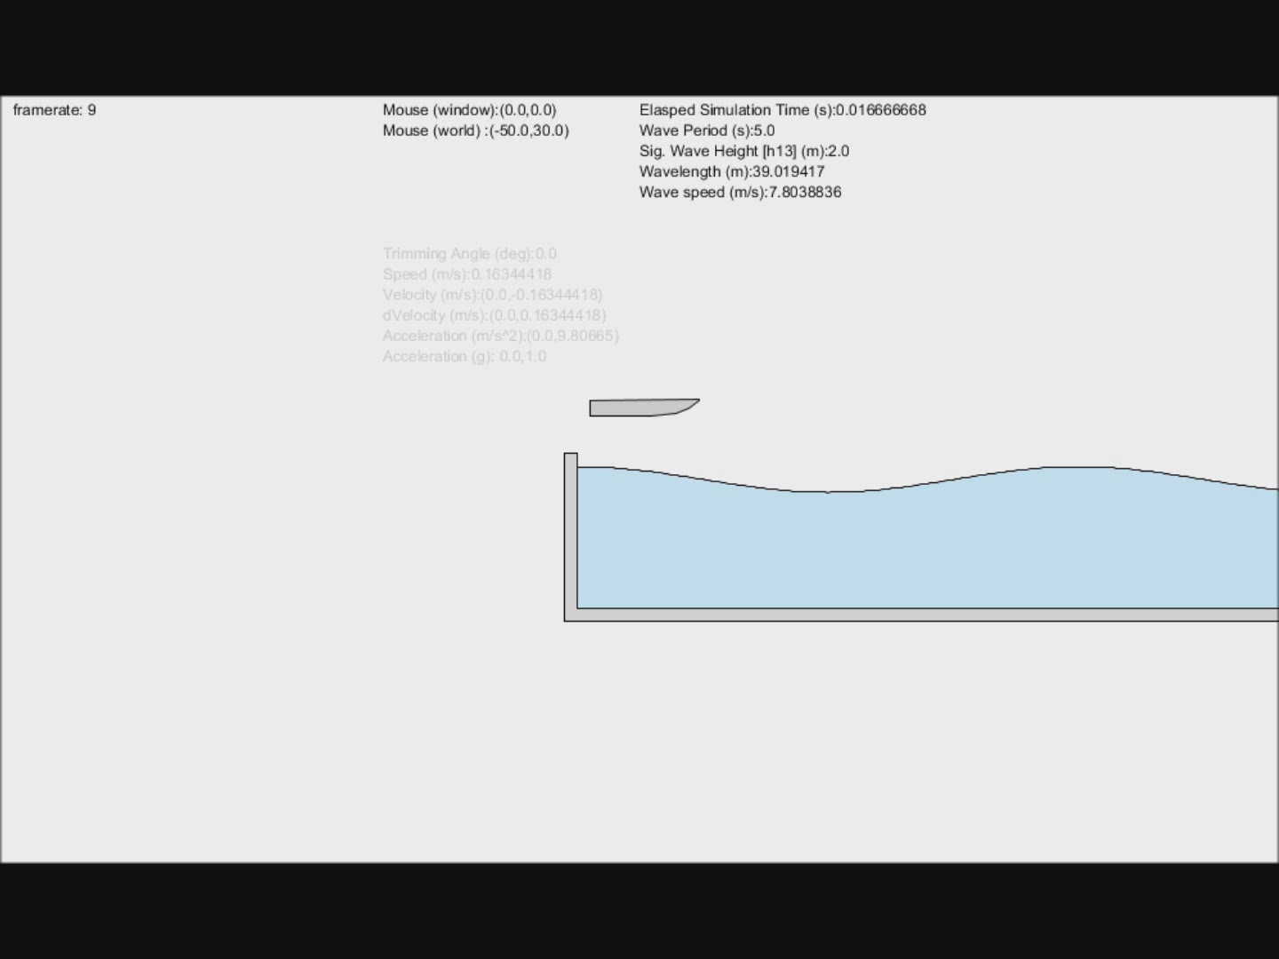
Early Experiments
Notes:
Early Experiments

Slide 14
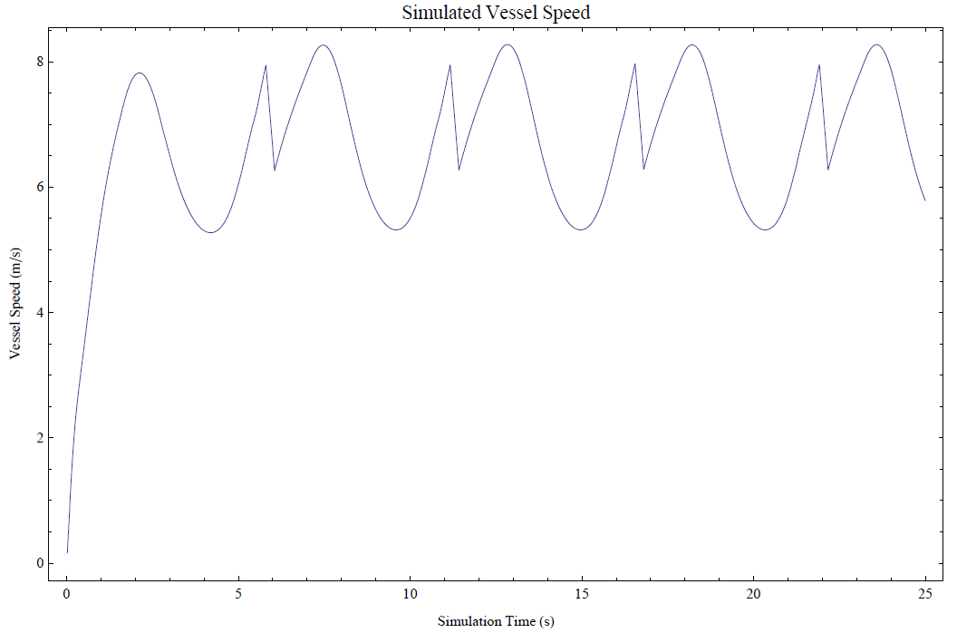
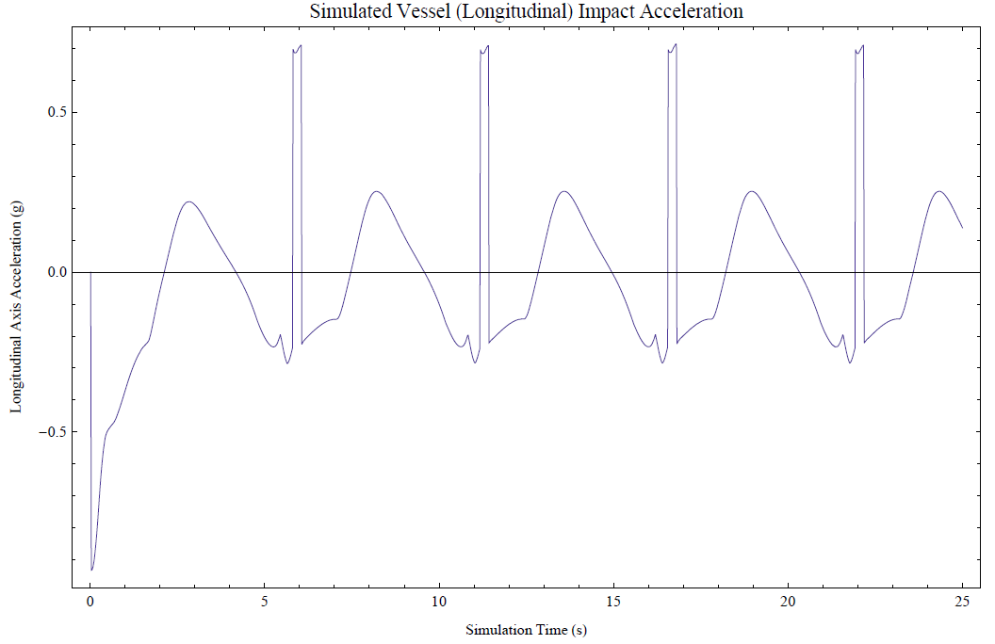
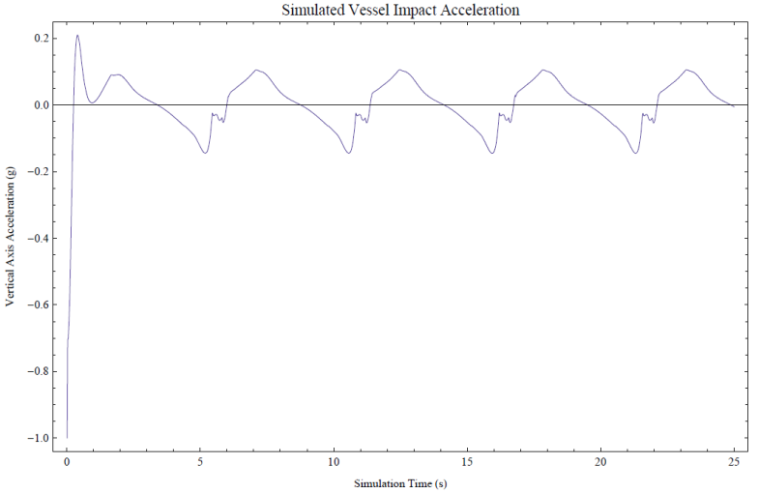
What data out of this simulation
TRIM ANGLE (deg)
SPEED (m/s)
VELOCITY [heave & surge] – m/s
ACCELLERATION [heave & surge (m/s^2)

Slide 15



Freely available resources
Processing IDE
https://processing.org/
Box-2D for Processing (Physics Engine)
https://github.com/shiffman/Box2D-for-Processing
https://box2d.org/
https://www.iforce2d.net/b2dtut/buoyancy
LiquidFun (Built on Box-2D)
http://google.github.io/liquidfun/
HullPool Simulator
https://github.com/mdlougheed/HullPool.git

Slide 16
MOVING FORWARD

Slide 17
How to deal with increasing physics complexity?
Faster processor?
Multi-core processors – parallel processing (up to 22 cores now on some server class CPUs)?
Network clusters – parallel processing?
OR – GPU!
Notes:
All of this physics engine stuff is well and good. With increasing complexity brings greater numberical overhead.

Slide 18
How to deal with increasing physics complexity?
Faster processor?
Multi-core processors – parallel processing (up to 22 cores now on some server class CPUs)?
Network clusters – parallel processing?
OR – GPU!
Notes:
All of this physics engine stuff is well and good. With increasing complexity brings greater numberical overhead.

Slide 19
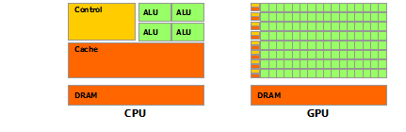
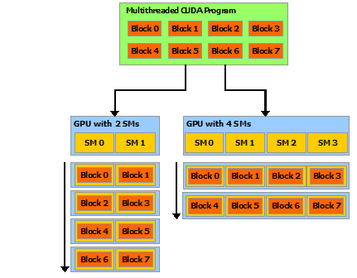
What is a GPU?

Slide 20
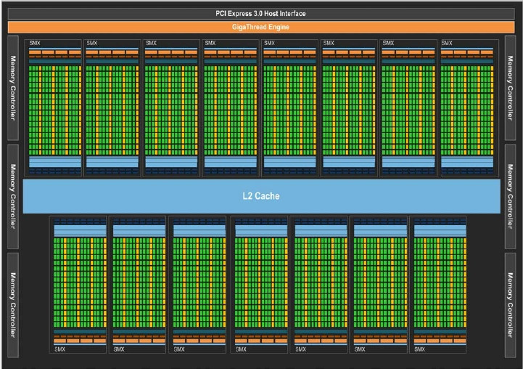
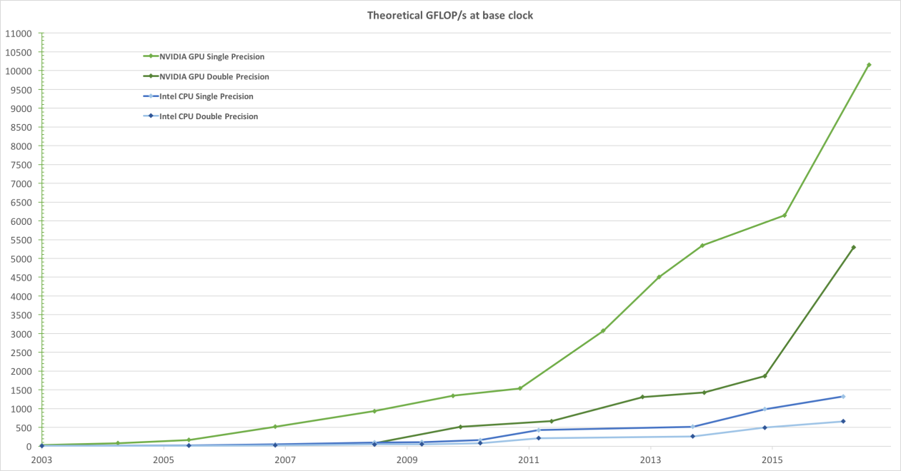
Graphics Processing Unit
High Performance Computing
Thousands of individual processors working in parallel.
NVIDIA & AMD Radeon
Notes:
3072 processors in the case of NVIDIA GeForce RTX 2080 Super

Slide 21
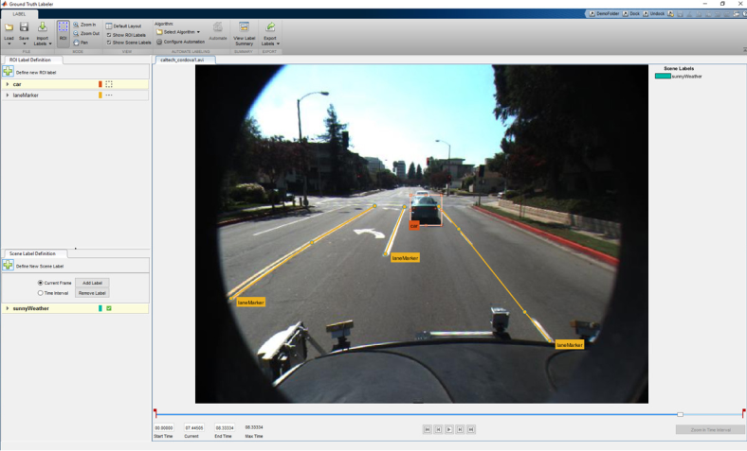
Other Applications
Artificial Intelligence (AI)/Deep Learning
Graphics & Simulation
Data Visualization
Autonomous Vehicles
High Performance Computing
BIG Data Analysis

Slide 22
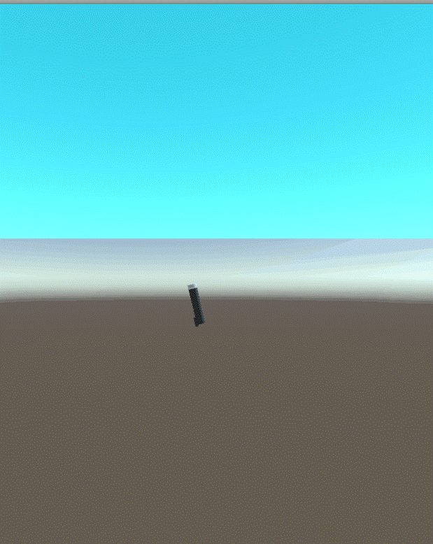
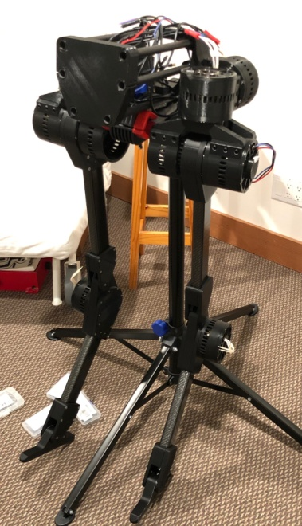
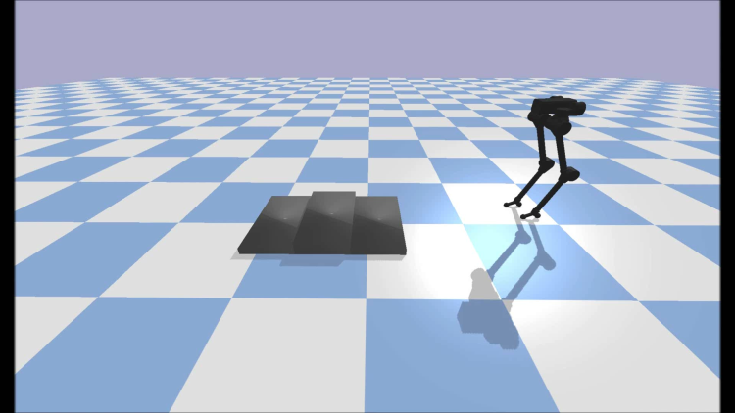
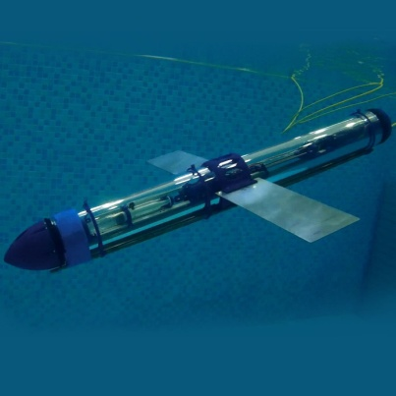
Other uses of Physics Engine
Bipedal Walking Robot Controller
Uses BULLET Physics
https://hackaday.io/project/160882-blackbird-bipedal-robot
Underwater Glider
Uses UNITY
https://hackaday.io/project/20458-osug-open-source-underwater-glider

Slide 23
INTEGRATED DEVELOPEMNT ENVIRONMENTS

Slide 24
INTEGRATED DEVELOPMENT ENVIRONMENTS
GDevelop – Box2D Physics Engine
Unity
Unreal Engine (UE) – Tightly integrated with NVIDIA PhysX physics engine
Pre-assembled integrations of other NVIDA HPC tools – WaveWorks, FLEX
Grasshopper (within Rhino 3D)*
Notes:
Integrations into freely available platforms such as Unreal Engine (UE) and Rhino 3D modelers
Rhino3D is not freely available – however ubiquitous and many grasshopper plug-ins are open source and freely available.

Slide 25
NVIDIA Libraries & Resources
Gameworks Modules for Unreal Engine
Phys-X
FLEX
WaveWorks
Integrations into freely available platforms such as Unreal Engine (UE) and Rhino 3D modelers

Slide 26

SIGN UP FOR ACCOUNTS
UNREAL ENGINE
https://www.unrealengine.com
Notes:
Freely available does not mean free for the taking.
Some resources will require signing up for an account. From there source codes and executables can be dowuloaded and installed.

Slide 27
SIGN UP FOR ACCOUNTS
UNREAL STUDIO
https://www.unrealengine.com
https://www.youtube.com/watch?v=7kFYZ4ZBr8g
Notes:
Unreal Studtio is a tool for preparing imported geometyr (Rhino) into UE4

Slide 28

SIGN UP FOR ACCOUNTS
NVIDIA DEVELOPER NETWORK
https://developer.nvidia.com/gameworks
https://github.com/NVIDIAGameWorks
WaveWorks
FLEX

Slide 29

SIGN UP FOR ACCOUNTS
UNITY
https://unity.com/

Slide 30
PREPARING 3D MODEL GEOMETRY

Slide 31
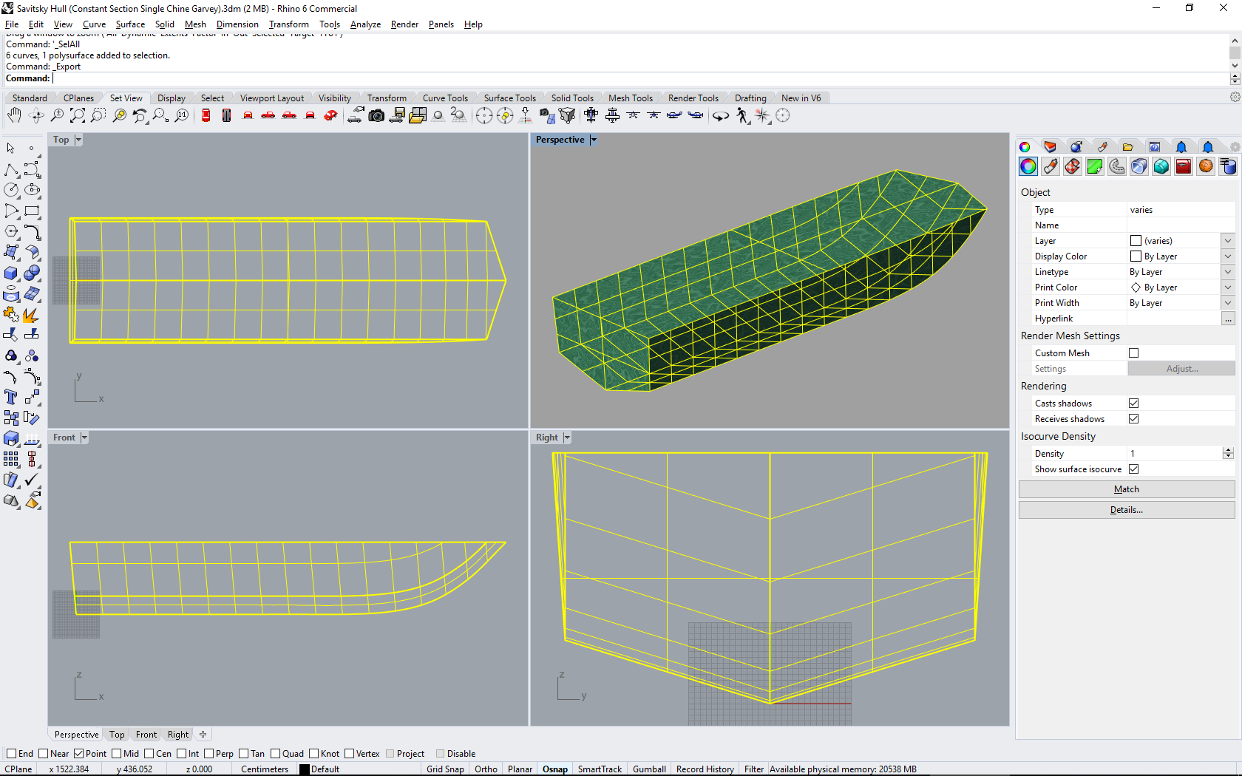
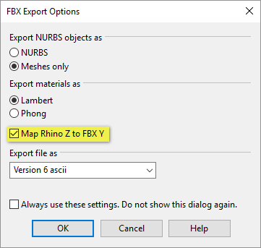
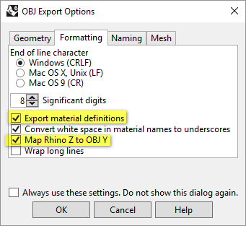
PREPARING MODEL GEOMETRY FOR IMPORT
PREPARE MODEL GEOMETRY
X axis – Positive toward bow
Y axis – Positive to PORT
Z axis – UP
UE Length Units are CM, Unity is in meters – scale appropriately
SIMPLE EXPORT AS “STL” OR “FBX” – STEREOLITHOGRAPHY MESH
COMPLEX EXPORT AS “OBJ” – EXPORTS BOTH STL GEOMETRY AND TEXTURES
TEXTURES MUST BE IMPORTED SEPERATELY

Slide 32
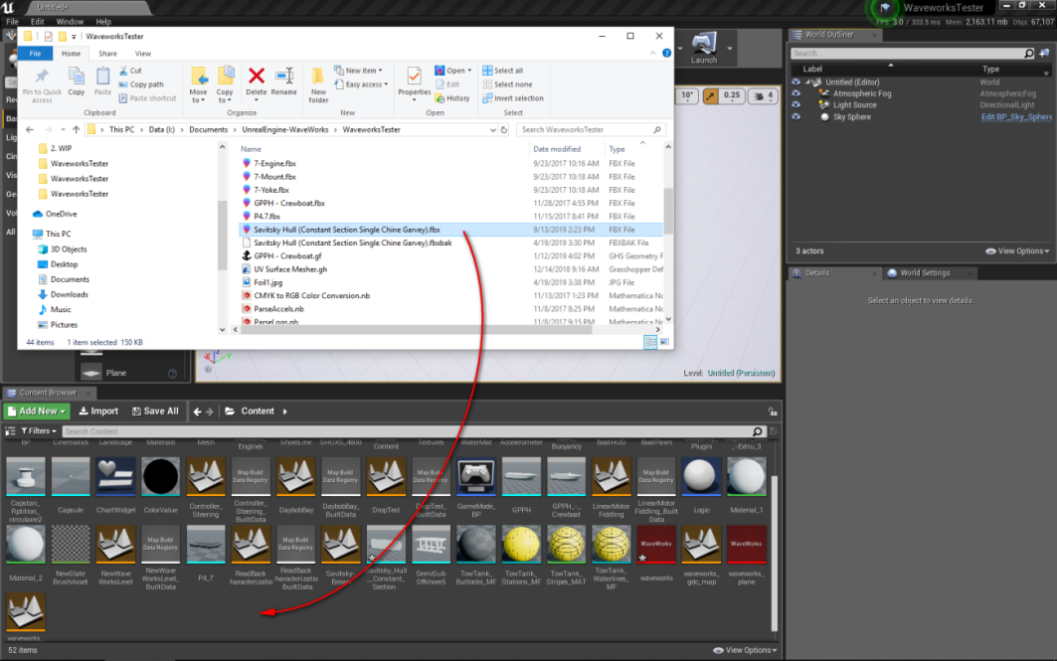
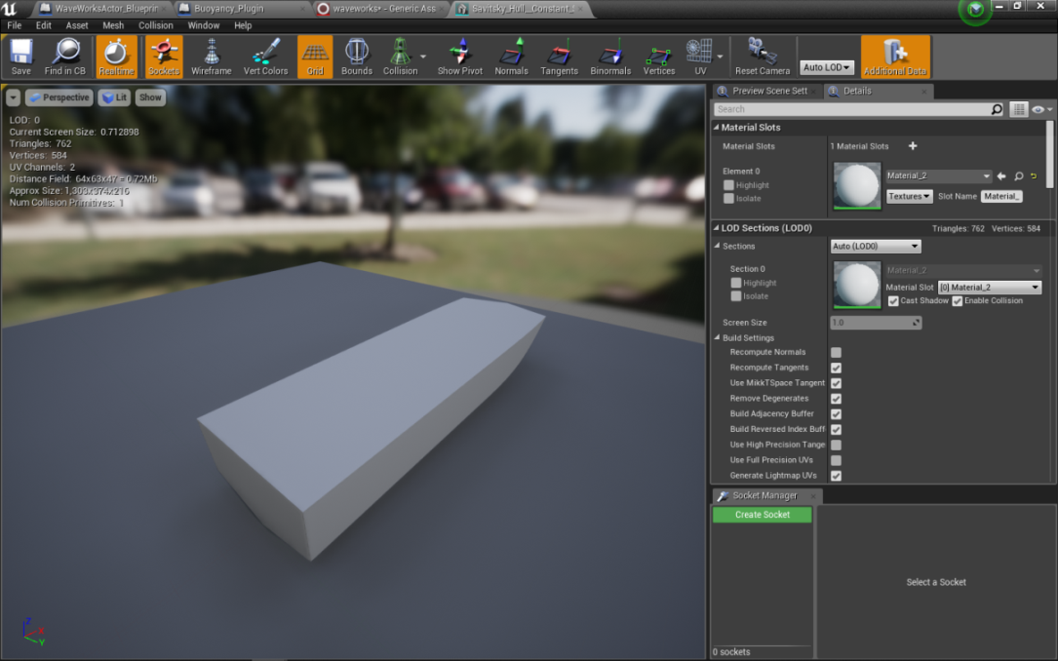
PREPARING MODEL GEOMETRY FOR IMPORT
Drag and drop the STL or FBX file into the content folder
Once import is complete double click to open the geometry for editing and checking.
Notes:
Content folders are arranged like file folders. You can create subfilders to organiza your project data.

Slide 33
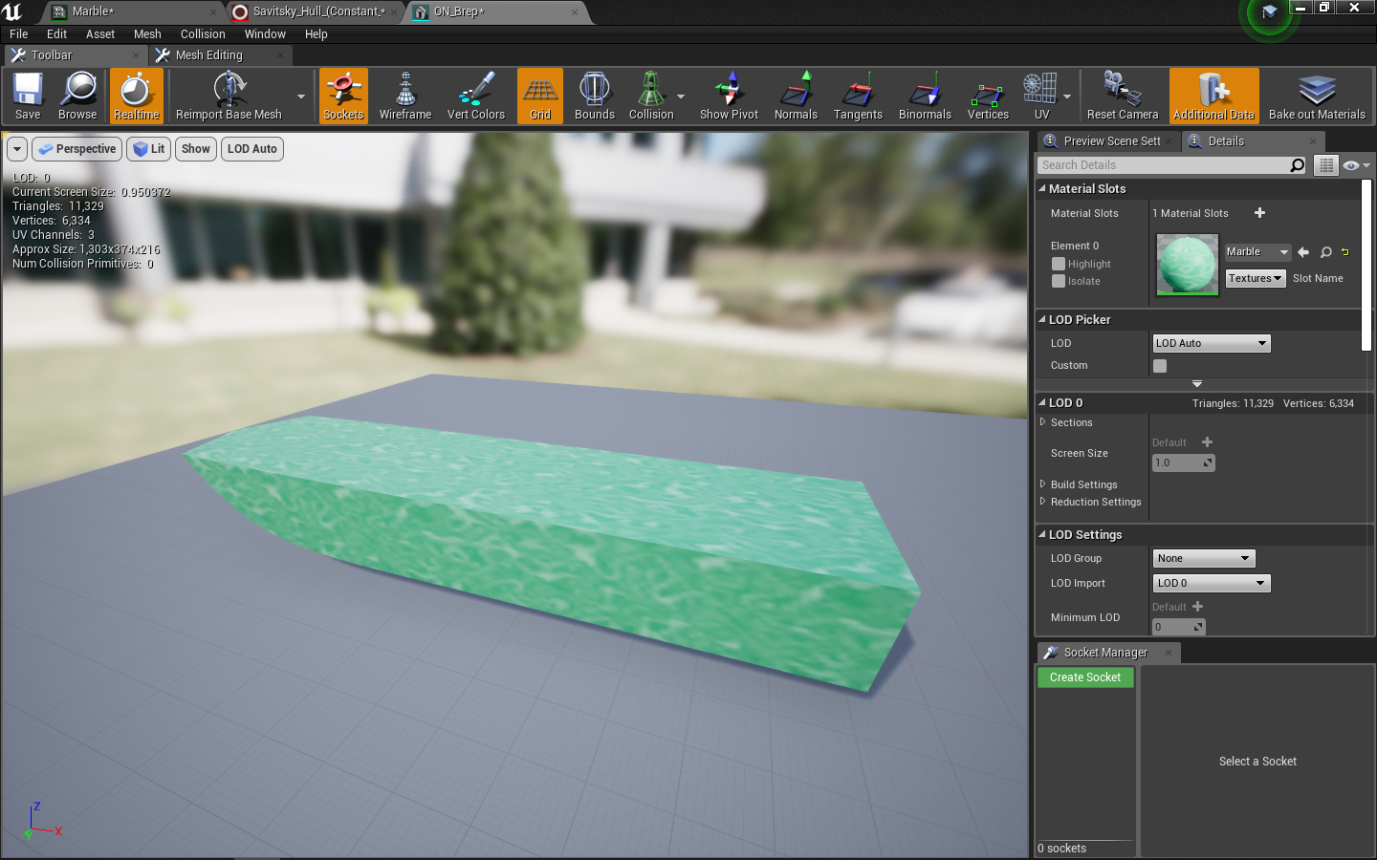
PREPARING MODEL GEOMETRY FOR IMPORT
ALTERNATIVELY
Use the Unreal Studio Datasmith plugin
Will import Rhino 3dm geometry and materials directly
Geometry and materials can be transferred to other versions of UE4 or UNITY.
Notes:
Content folders are arranged like file folders. You can create subfilders to organiza your project data.

Slide 34
SETTING UP WAVEWORKS

Slide 35
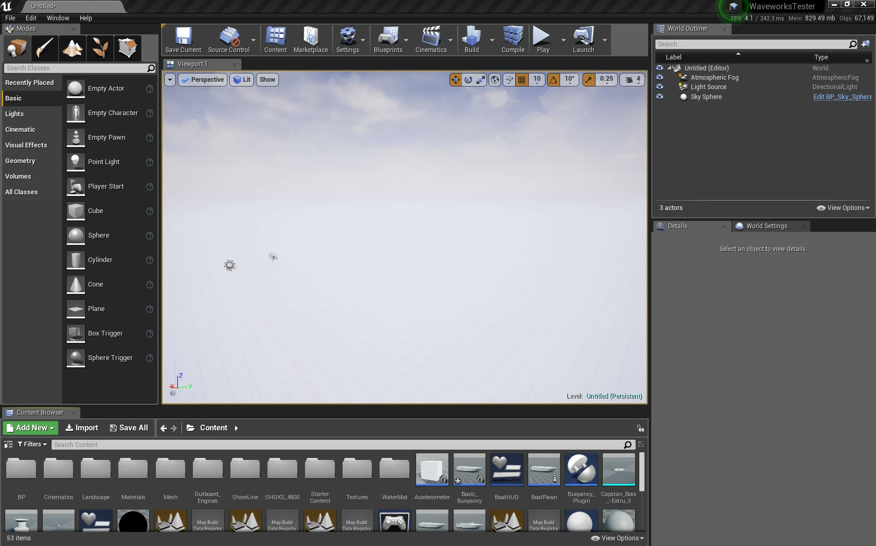
SETTING UP WAVEWORKS

Slide 36
MAKING THE MODEL BOUYANT

Slide 37
PROGRAMMING WITHOUT CODING

Slide 38
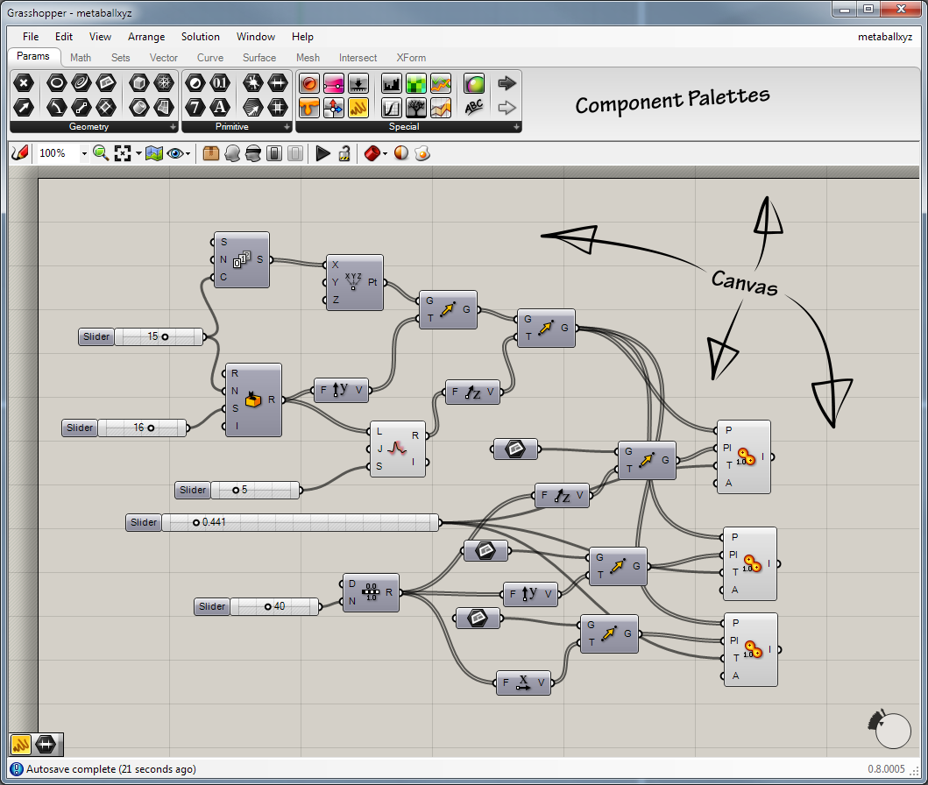
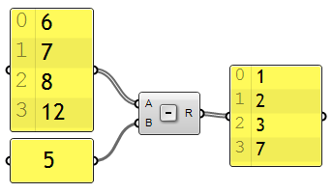
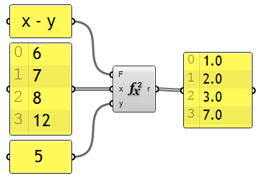
PROGRAMMING WITHOUT CODING
We’ll see this graphical and interactive programming style in UE4 “Blueprints” as well
For example, many VPLs (known as dataflow or diagrammatic programming)^{[3]} are based on the idea of "boxes and arrows", where boxes or other screen objects are treated as entities, connected by arrows, lines or arcs which represent relations.
Scratch
Grasshopper
UE4 Blueprint
Playmaker for Unity
Simulink in MATLAB

Slide 39
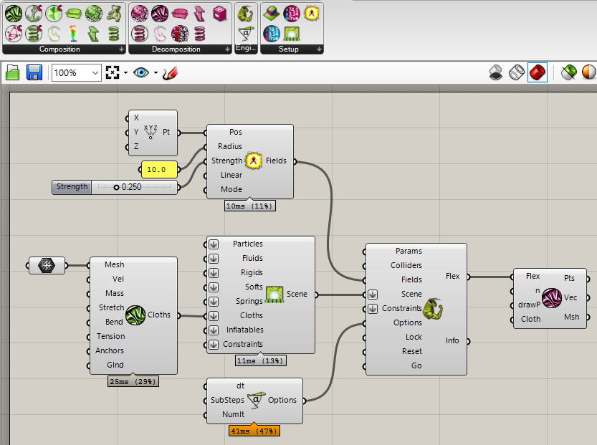
PROGRAMMING WITHOUT CODING
Integrated Environments
GDevelop – Box2D Physics Engine
Unity
Unreal Engine (UE) – Tightly integrated with NVIDIA PhysX physics engine
Pre-assembled integrations of other NVIDA HPC tools – WaveWorks, FLEX
Grasshopper (within Rhino 3D)*
Notes:
Main idea behind grasshopper is that it is tightly bound to Rhino and can produce Rhino geometry algorithmically
Programming without coding
High level Grasshopper functional blocks work together to provide high level operations on vast amounts of data.
“Wire” interconnections visually show the flow of data and their operations.
Geometry data is output directly into Rhino, so the process is interactive
Derived data can be “baked” into geometry that can be directly used in Rhino.
File I/O
Math operations (Point, 2D & 3D vectors, meshes, surfaces & solids)
User input parameters
Input can be bound to specific geometry in Rhino

Slide 40
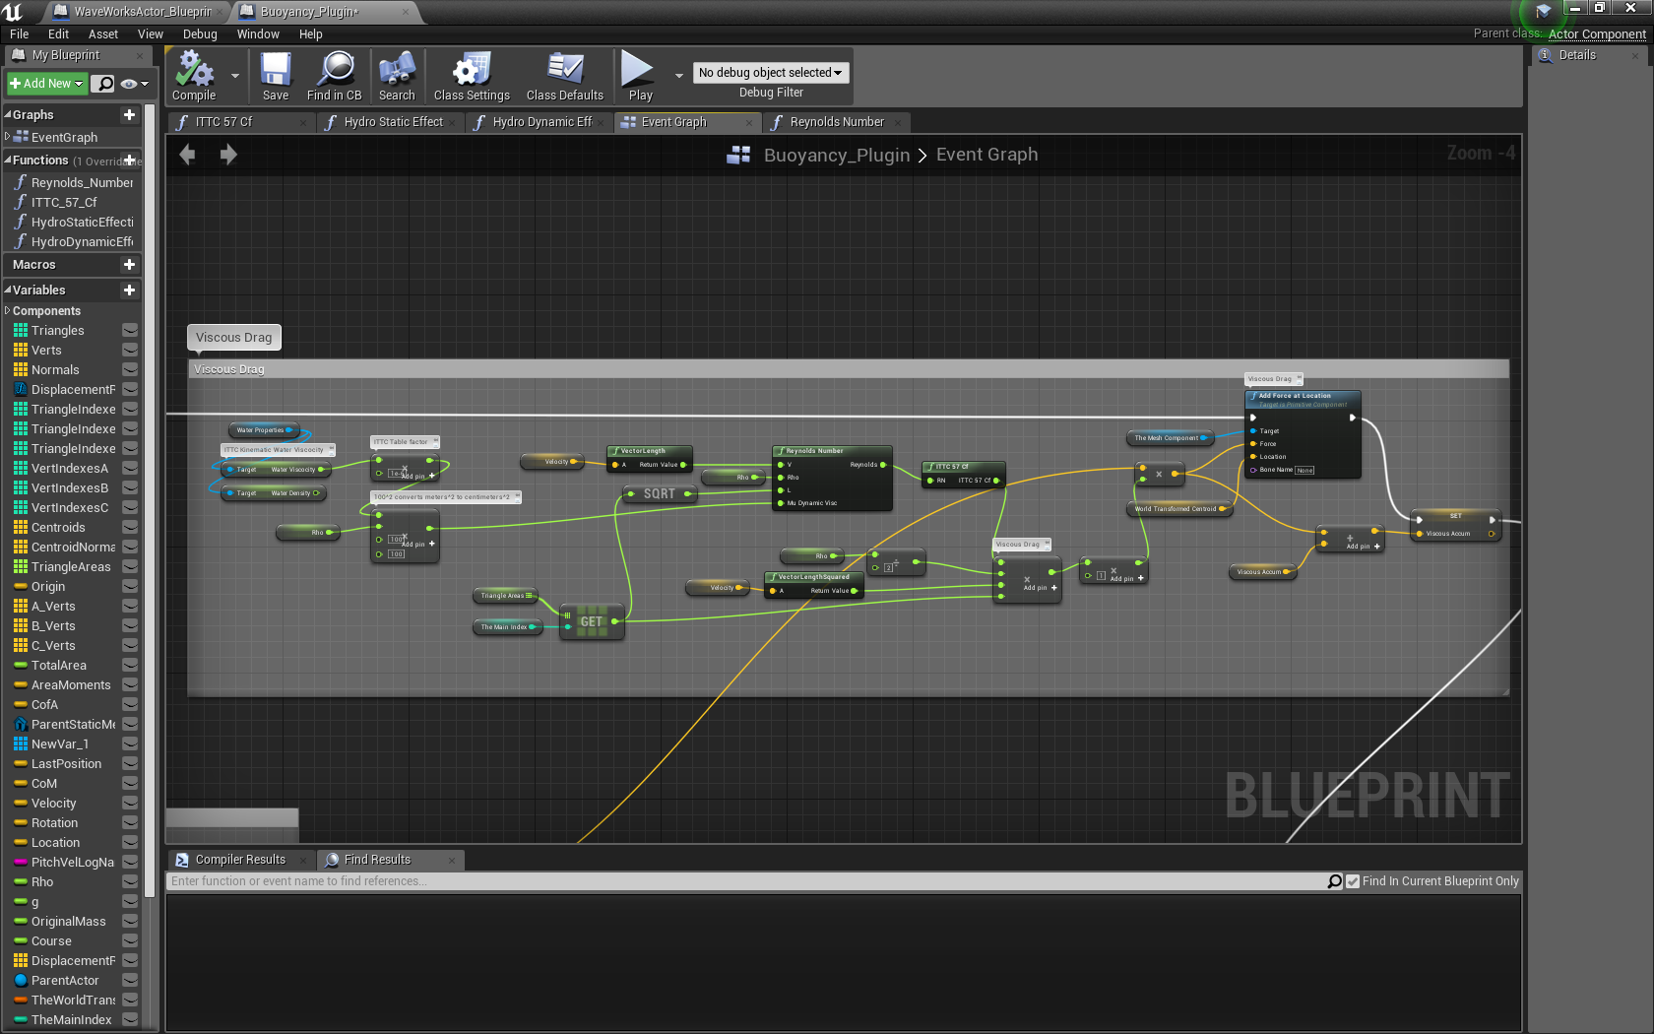
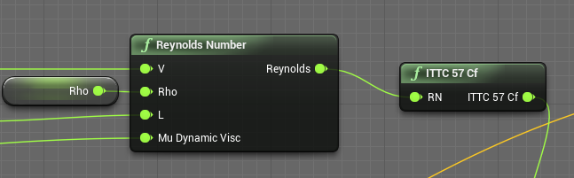
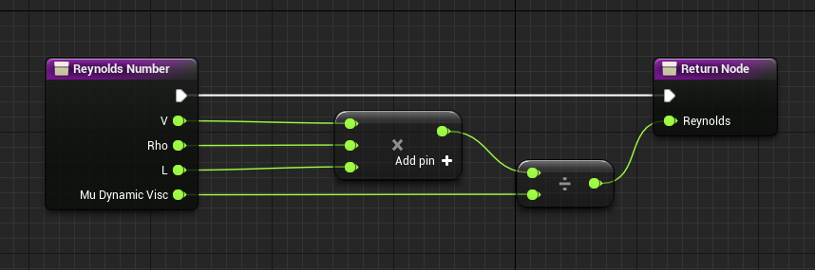
UE4 BLUEPRINT EXAMPLE – REYNOLDS NUMBER

Slide 41
USING AS AN ANALYTICAL TOOL

Slide 42
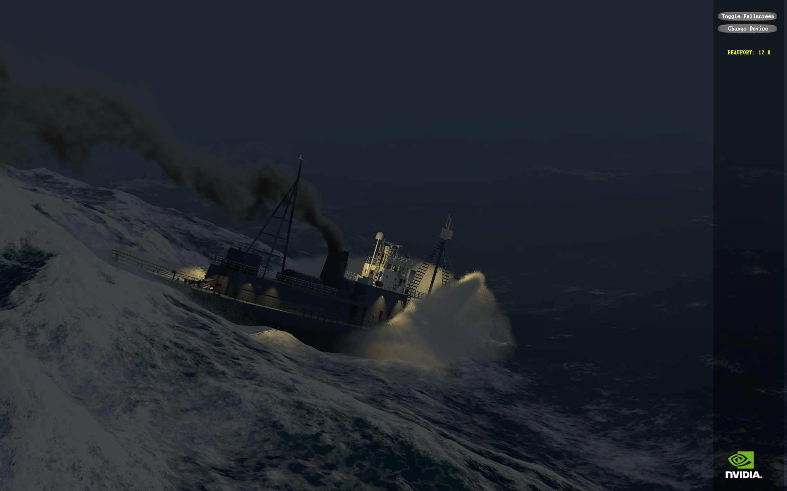
IS WAVEWORKS A GOOD OCEAN SIMULATION?
Notes:
This was examined from several points of view – spectrally and temporally
Comparison to PM Spectrum for various winds based on Beaufort scale
Analysis of wave heights and periods
Comparison to Douglas and Wilbur Marks sea state scales
Answer YES!!!

Slide 43
Notes:
First thing to understand is Beaufort Force IS NOT Sea State – Here’s the correlation based on the Wilbur Marks scale.

Slide 44
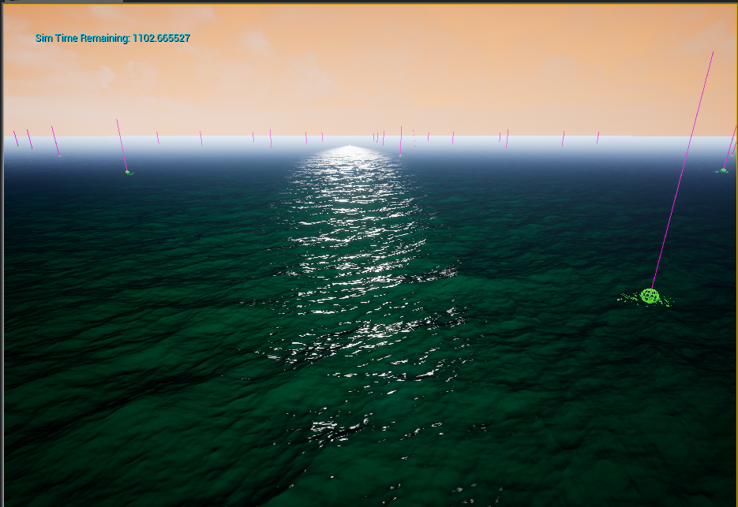
HOW WAS OCEAN DATA COLLECTED?

Slide 45
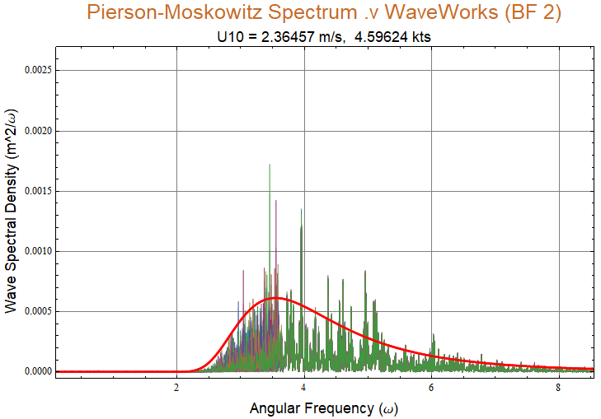
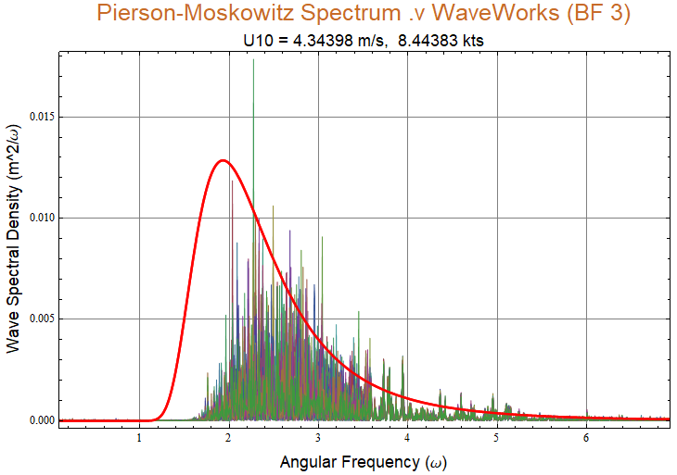
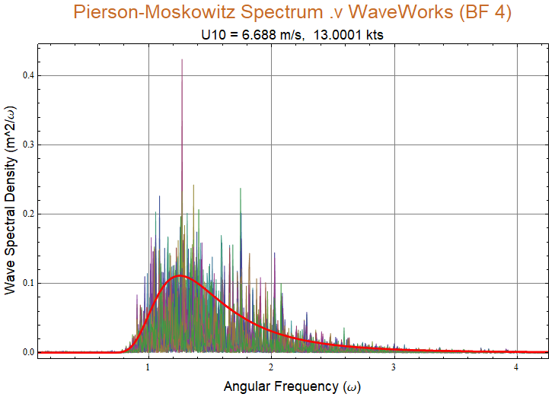
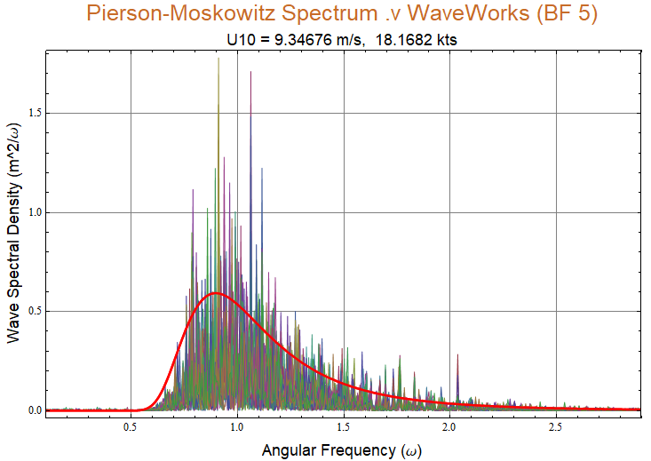
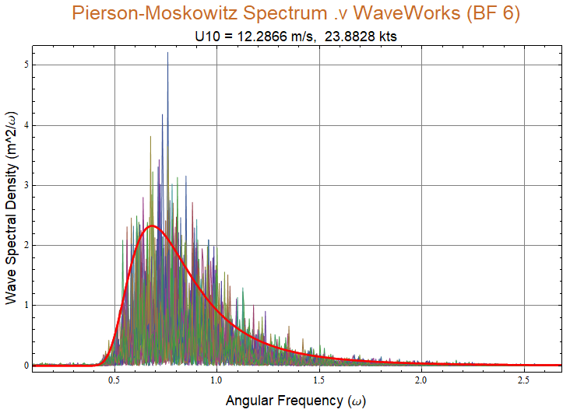
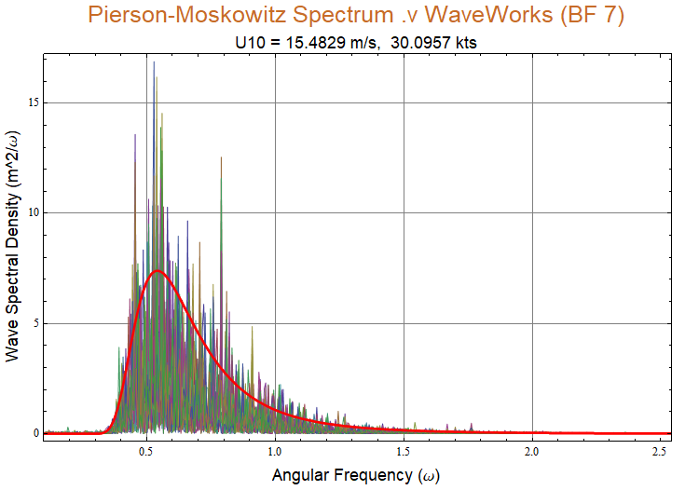
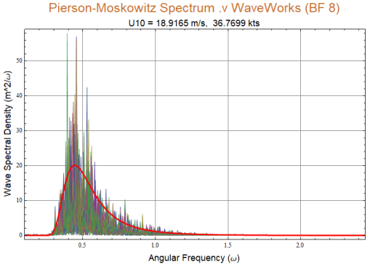
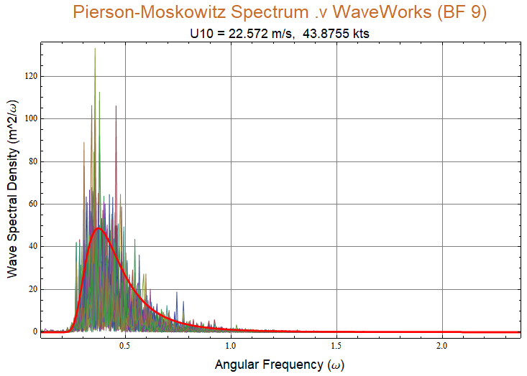
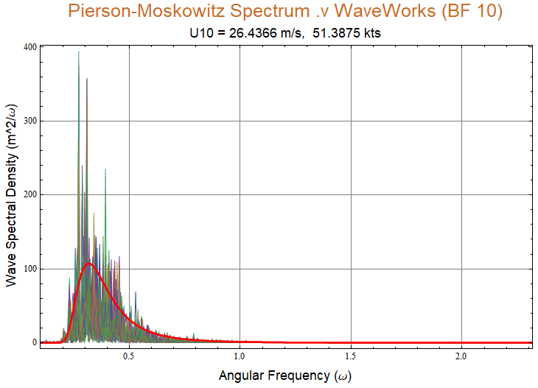
Notes:
Spectrallly
Comparison of measured Spectrum to PM spectrum based on Beaufort Force wind speeds.
Time constant for simulatuion was adjusted to 0.818 for best fit to spectra
100 x 100 meter sample area
20 minute sample at 25 differenct locations
BF 0 through BF-10
Sampling frequencies from 111 to 119 sps – speed depended on complexity of ocean surface simulation complexity – your performace may vary significantly depending on the graphics card technology. This simulation done on NVIDIA RTX-2080

Slide 46
WaveWorks Beaufort Force .vs Significant Wave Height (H13)
WWBF | Wind Speed (m/s) | Wind Speed (knots) | H13(m) | H13(ft) | Average Wave Period (s) |  | Sea State (Wilbur Marks) | Douglas SS (Computed from measured waveheights)
0 | 0.0 | 0.0 | 0.000 | 0.000 | 0.0 |  | 0 | 0
1 | 0.8 | 1.6 | 0.024 | 0.080 | 0.5 |  | 0 | 1.03
2 | 2.4 | 4.6 | 0.149 | 0.488 | 1.2 |  | 1 | 1.68
3 | 4.3 | 8.4 | 0.340 | 1.115 | 1.6 |  | 2 | 2.06
4 | 6.7 | 13.0 | 1.294 | 4.244 | 3.0 |  | 3 | 3.17
5 | 9.3 | 18.2 | 2.469 | 8.101 | 3.9 |  | 5 | 4
6 | 12.3 | 23.9 | 4.549 | 14.925 | 5.4 |  | 6 | 5
7 | 15.5 | 30.1 | 7.553 | 24.779 | 6.4 |  | 7 | 6.11
8 | 18.9 | 36.8 | 10.464 | 34.329 | 8.0 |  | 7 | 7.4
9 | 22.6 | 43.9 | 18.811 | 61.716 | 10.7 |  | 8 | 8.9
10 | 26.4 | 51.4 | 26.130 | 85.727 | 13.0 |  | 9 | 10.3
Notes:
Temporally

Slide 47
EXPERIMENTS: SAVITSKY-BROWN DESIGN ACCELERATIONS

Slide 48
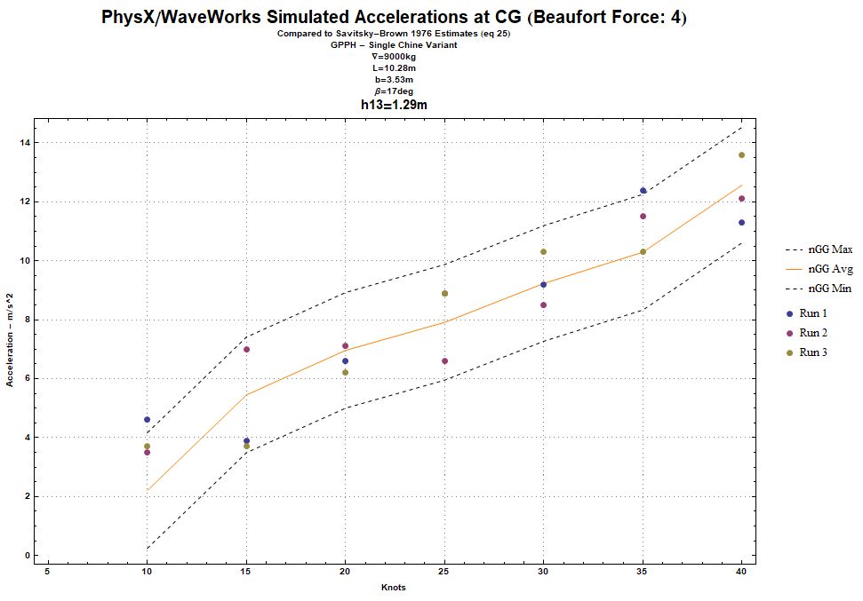
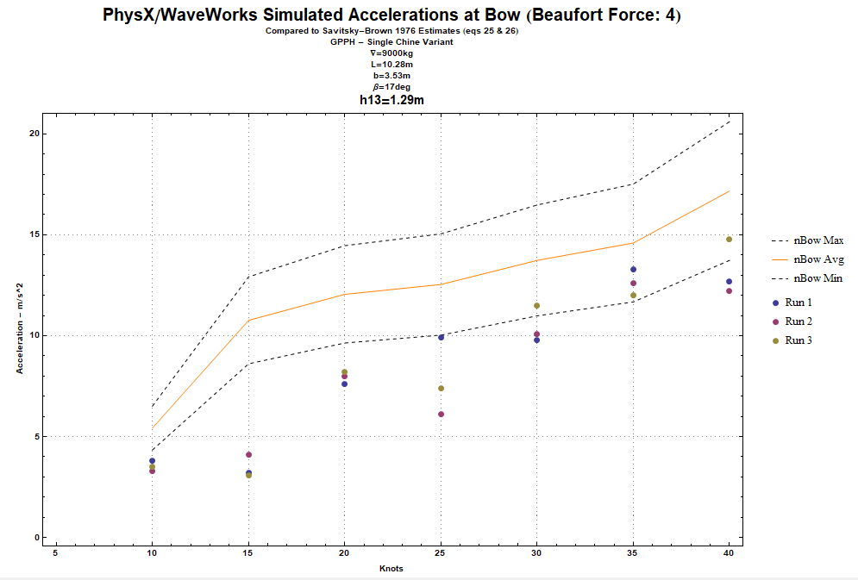
Notes:
Beaufort force 4 – approximately SS 3 on the Wilbur Marks Scale. Typical Envoronment for perfromance evaluatoin.

Slide 49



Slide 50
EXPERIMENTS: PLANING BOAT TURN RADIUS ESTIMATION

Slide 51



TURN RADIUS
BACKGROUND
Notes:
Turning circle diameter
This equation can be rearranged to yield the minimum turning radius for a pleasure craft or passenger vessel as a function
of speed where the acceleration does not exceed 0.35 g’s (3.43m/s2). And considering that yaw angles of high speed
monohulls are typically less than 10 degrees, and that the cosine of angles less than 10 degrees has a value of essentially
1.0, the equation can ultimately be simplified as follows:
The relationship between the steady turning velocity, UC, and the approach (initial) velocity, varies from vessel to vessel,
and can be predicted or measured on sea trials. Using the equation above, Figure 11 presents the minimum turning
diameter as a function of approach velocity (in knots) for typical UC/UA values of 0.75 to 0.95. The execution of turning
maneuvers with smaller turning diameters than shown in this figure will result in transverse accelerations greater than 0.35
g’s and therefore should not be conducted.

Slide 52


Slide 53




TURN RADIUS
10 KNOTS
CASE STUDY
Notes:
GPPH Single Chine Monohull – Hard over 30 deg
10kts speed: A little variant because of the unsteady nature of the simulated vessel – and my PID speed control SUCKS!
Yaw angle: -3.56 degrees (Left Hand Turn)
Course vs. Heading: Course lags (is less than) Heading by yaw angle of 3.6 degrees. Sawtooth pattern is a heading goes through 360 degrees
Turning radius of about 110m -> 220m diameter UC/UA MUCH MUCH LESS THAN 0.95 (well within an acceptable turning diameter for this speed)

Slide 54




TURN RADIUS
20 KNOTS
CASE STUDY
Notes:
GPPH Single Chine Monohull – hard over 30 deg
20kts speed: A little variant because of the unsteady nature of the simulated vessel – and my PID speed control SUCKS!
Yaw angle: -4 degrees (Left Hand Turn)
Course vs. Heading: Course lags (is less than) Heading by yaw angle of 4 degrees. Sawtooth pattern is a heading goes through 360 degrees
Turning radius of about 80m -> 160m diameter UC/UA of about 0.85 (Right in the middle of the Bowles predicted range.

Slide 55




TURN RADIUS
30 KNOTS
CASE STUDY
Notes:
GPPH Single Chine Monohull – hard over (30 deg)
30kts speed: Yaw angle: 8.75 degrees (Left Hand Turn)
Course vs. Heading: Course lags (is less than) Heading by yaw angle of 8.75 degrees. Sawtooth pattern is a heading goes through 360 degrees
Turning radius of about 160m -> 300m diameter UC/UA of about 0.775 (Within the Bowles Range)

Slide 56
EXPERIMENTS: SHOCK MITIGATING SEAT SIMULATION

Slide 57


Slide 58

OPEN OCEAN PROJECT – FOR UE4
ANOTHER FREELY AVAILABLE RESOURCES
https://github.com/UE4-OceanProject/OceanProject

Slide 59
FURTHER WORK

Slide 60


Slide 61


Slide 62
IMPROVE PHYSICS & INTERACTIVITY
Better viscosity and dynamic displacement physics effects
Reduce dependence on hardcoded linear and angular damping for model stability.
Improve “Game Play”
Interactive simulation and training scenarios
Ease of setup
Improved use of real-world map importing

Slide 63

NVIDIA FLEX + Rhino 3D = FlexHopper
https://www.food4rhino.com/app/flexhopper
Written buy Benjamin Heinz and ported as a Rhino3D Grasshopper Module
Slow due to overheads associated with both Rhino3D and Grasshopper

Slide 64

INTEGRATE GPU SIMULATION INTO CAD ENVIRONMENTS
Custom FFT Ocean module for Grasshopper

Slide 65
WAVEWORKS 2.0

Slide 66


Slide 67
THANK YOU!

